Slide 1

Inventory management
IPD12 - ASP.net – Team project by jing wang, jie zhu

Slide 2
Agenda
Front-End
Login and Register
Publish

Slide 3
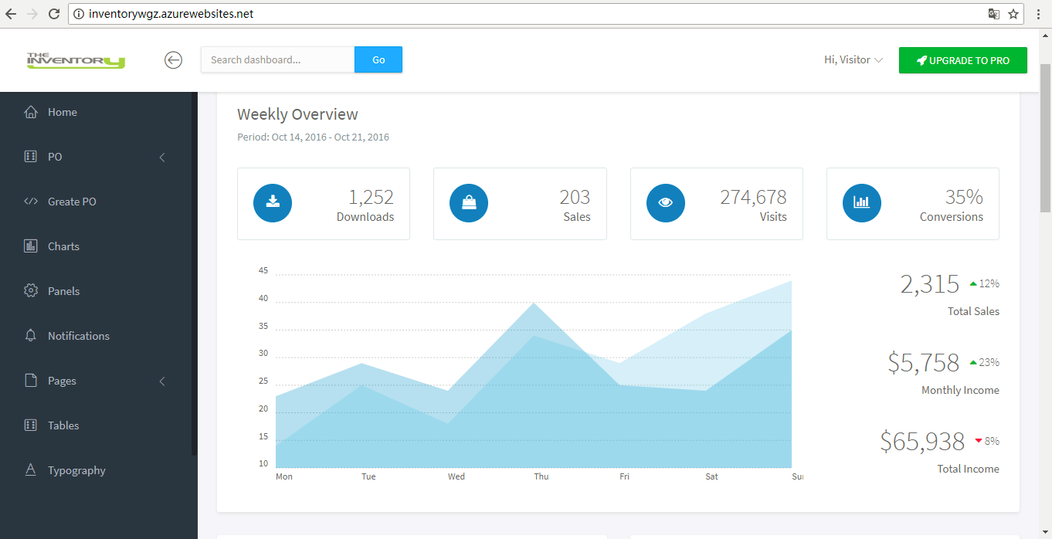
Front-End
Step1:
Search Theme
Download Theme
Understand Theme
Step2:
_Navbar.cshtml
Divide Theme
_Sidebar.cshtml
_footer.cshtml
Step3:
*.css
fonts
Bundle
Create layout
Image src:
<img src="@Url.Content("~/assets/img/Logo.png")"/>
*.js

Slide 4
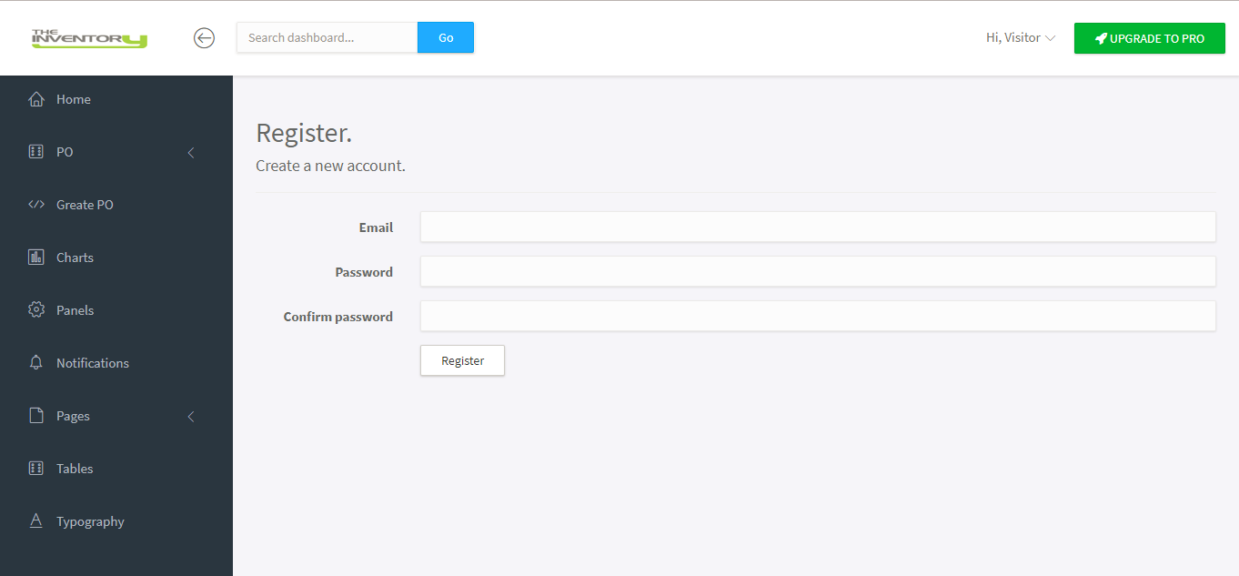
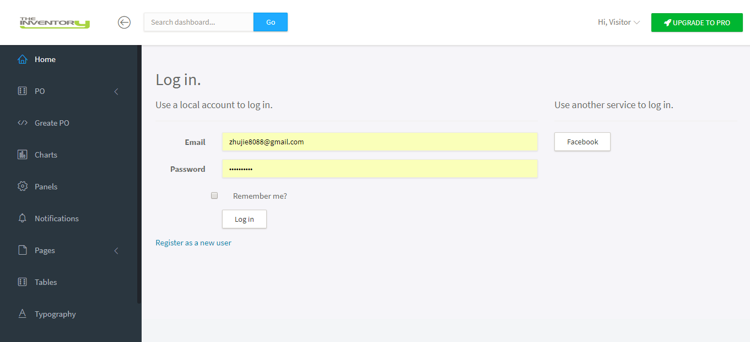
Register and login

Slide 5
Publish(1/2)
Azure Service
Web Application
Stop service
Add SQL Server to resource
Free account
Web Application
+
SQL Server
Start service
Paid account
Other services

Slide 6
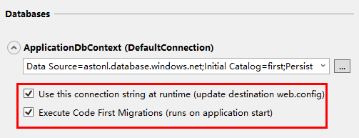
Publish(2/2)
Deploy
Existing Solution
Automatically
Migration
Local Database
New Solution
Azure SQL Server

